Slide 1

The use of Generalized Linear Mixed Models for the study of dynamical systems
Andrés Garchitorena
Researcher, Institut de Recherche pour le Développement
Research Advisor, PIVOT Madagascar
E²M² Workshop
Ranomafana, December 2022

Slide 2
1
Objectives of the lecture
1
1
Understand alternatives to the use of mathematical models for the study of dynamical systems
Remind some basic principles of linear regression and statistical models
Introduce the use of generalized linear mixed models for the study of dynamical systems
Provide an overview of the steps involved in developing a generalized linear mixed model (tutorial)

Slide 3
Why statistical models if my system is dynamic?

Slide 4
1
Example of utilization trends
1
1
Legend
CSB1
CSB2 PAUSENS
CSB2 PAUSENS + PIVOT
Model predictions with program(s)
Model predictions without program(s)
PIVOT Program
Pausens Program
2013
2014
2015

Slide 5
1. Univariate
Linear Models
Some basics first…

Slide 6
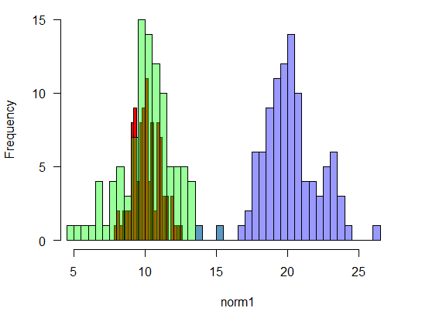
1
1
1
Variables and distributions

Slide 7
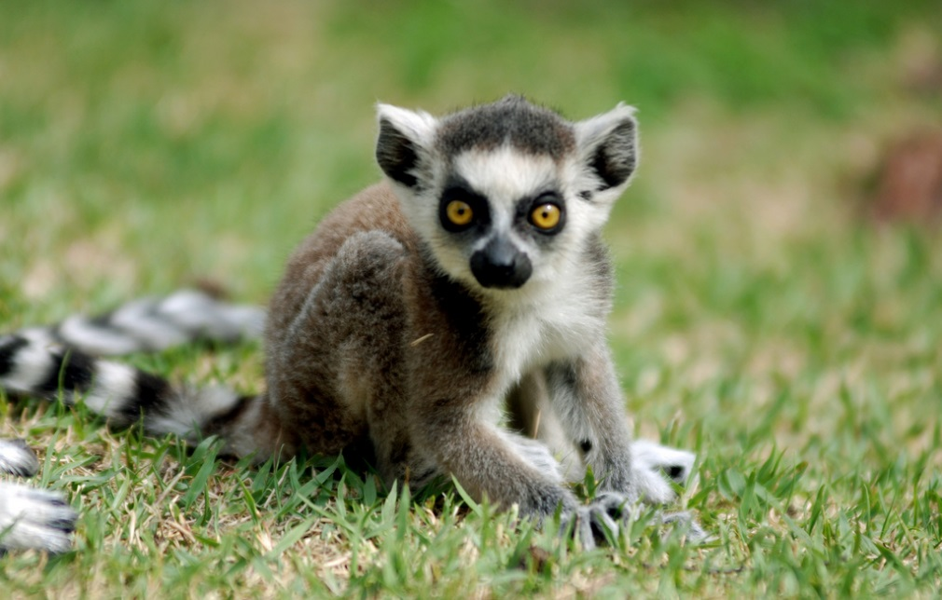
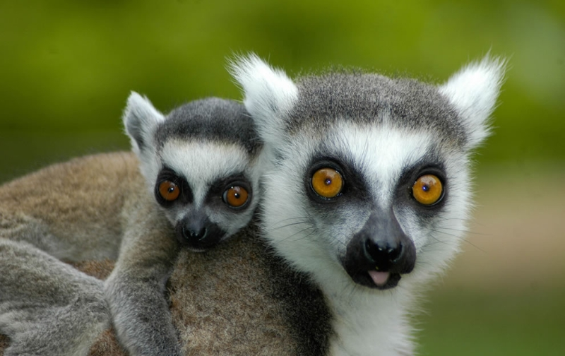
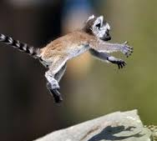
1
1
1
Let’s work through a cute example

Slide 8
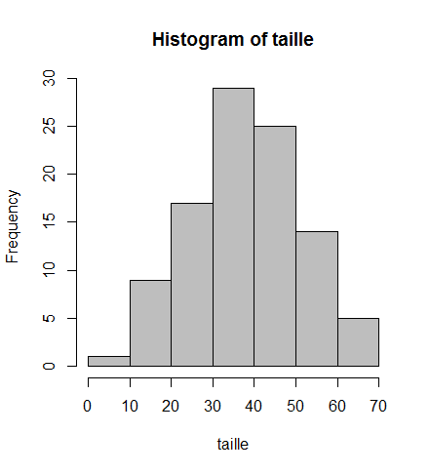
1
1
1
Lemur weight and determinants

Slide 9
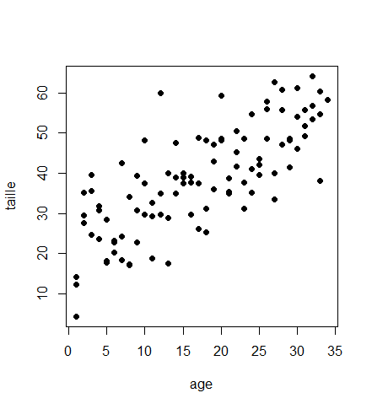
1
1
1
Lemur weight and determinants

Slide 10

1
1
1
Lemur weight and determinants

Slide 11
1
1
1
Lemur weight and determinants
The goal is to minimize the difference between what we predict and what we observe

Slide 12
1
1
1
Simple linear regression
Relation between 2 continuous variables
Intercept (α)
Value of y when x is 0
Regression coefficient β₁
Measures association between y and x
Amount by which y changes on average when x changes by one unit
Error (ε)
Difference between the predicted values and observed values of y
y
Slope (β)
x
Notes:
12
Measure the slope
Beta 1 is the slope
Alpha is the intercept, is the baseline
Beta is the magnitude by which y changes when x changes by one unit
Least square method: sum of all squared deviations. If the sum of all deviations is low, the line is explaining well the association between age and SBP.
Explain least square method on whiteboard

Slide 13
1
1
1
Simple linear regression
y = α+ β*x + ε
Systematic
component
Residual
component
Response variable =
+
Intercept and explanatory variables
- Null mean
- Independence
- Fixed variance
- Normality
The R function to fit a linear model is lm() which uses the form
fitted.model <- lm(formula, data=data.frame)

Slide 14
1
1
1
Simple linear regression
Taille = 20 + 1.15 x Age (months) + Error

Slide 15
A process is generally the result of several others…

Slide 16
1. Univariate
Linear Models
2. Multivariate
Linear Models
Introducing multivariate
linear models

Slide 17
1
1
1
Lemur weight and determinants

Slide 18
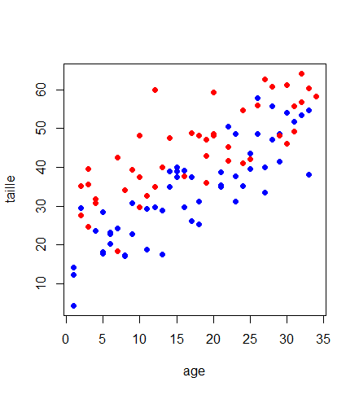
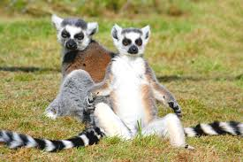
1
1
1
Lemur weight and determinants
The effect of gender

Slide 19
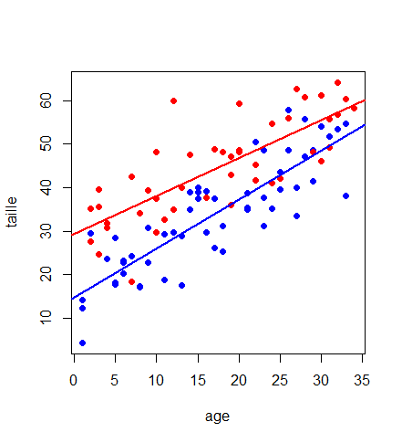
1
1
1
Lemur weight and determinants
The effect of gender
Taille = 15 + 1.15 x Age (months) + 15 x Sexe (Female) + Error

Slide 20
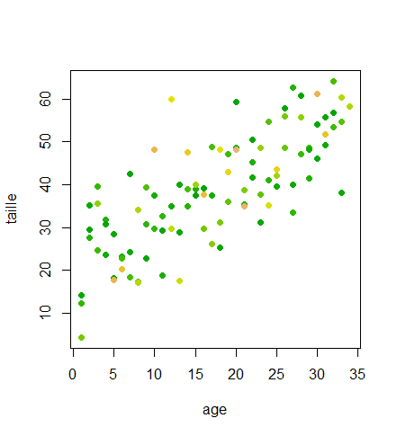
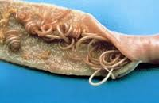
1
1
1
Lemur weight and determinants
The effect of parasites
Green: low GI parasite burden
Yellow: high GI parasite burden

Slide 21
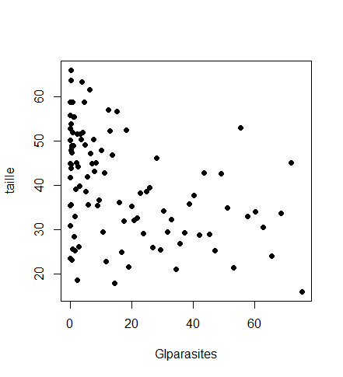
1
1
1
Lemur weight and determinants
The effect of parasites

Slide 22

1
1
1
Lemur weight and determinants
The effect of parasites
Taille = 45 - 0.3 x Nb Parasites + Error

Slide 23
1
1
1
Multiple linear regression
Generalization of simple regression
To describe the relationship between
The response variable, y
The explanatory variables, x = (x₁,x₂,…,x_{n})
The model: y = α+ β₁*x₁ +…+ β_{n}*x_{n}+ ε
with ε ~N(0,σ²)
We generally select the model that best fits the data (best explains observed patterns) with the smallest number of variables

Slide 24
Unfortunately, not all things in life are normal…

Slide 25
1. Univariate
Linear Models
2. Multivariate
Linear Models
3. Generalized
Linear Models
Introducing generalized
linear models

Slide 26
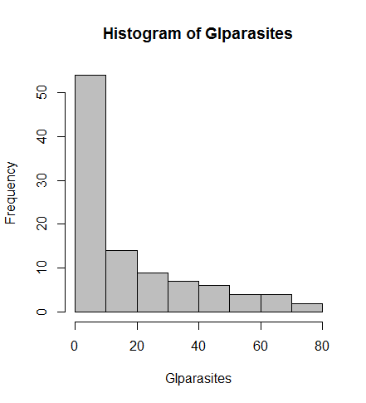
Count data
Cannot be negative
Discrete values
The lower the values, the « less normal » they generally are.
Examples:
Number of individuals of a species X
Number of people with a disease X

Slide 27

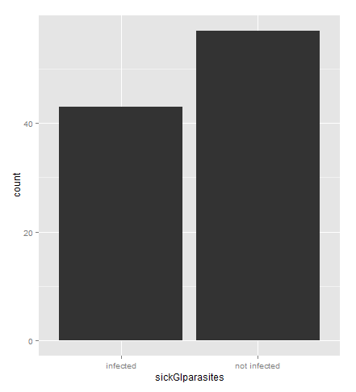
Binary data (events)
Values either 1 or 0 (either happened or not happened)
The outcome variable is the number of successes /failures
Examples:
Presence of a species X
Presence of a disease X

Slide 28
Limitations of linear models
In this type of situations, general linear models are not appropriate because:
The range of Y is restricted (e.g. binary, count)
The variance of Y depends on the mean
Generalized linear models extend the linear model framework to address both of these issues by using a linear predictor and a link function
The R function to fit a general linear model is glm() which uses the form
fitted.model <- glm(formula, family=“model family”, data=data.frame)

Slide 29
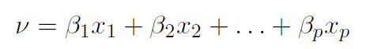
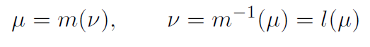
Generalized linear modeling
One generalization of multiple linear regression. Response, y, predictor variables x₁, x₂, …. The distribution of Y depends on the X’s through a single linear function, the “linear predictor”
A link function describes how the mean E(Y) = μ, depends on the linear predictor v.

Slide 30
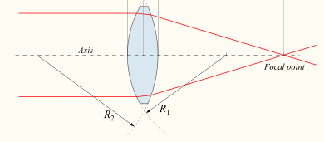
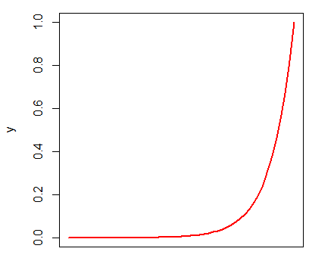
Generalized linear modeling
Most common families and links
Gaussian: identity
Poisson: log
Binomial: logit
Negative binomial: log
Y= e ^{(α + β x)}
V = α + β x
v
(log)
β
x
x

Slide 31
Generalized linear modeling
Most common families and links
Gaussian: identity
Poisson: log
Binomial: logit
Negative binomial: log
(logit)
V = α + β x
v
β
y
x
x

Slide 32

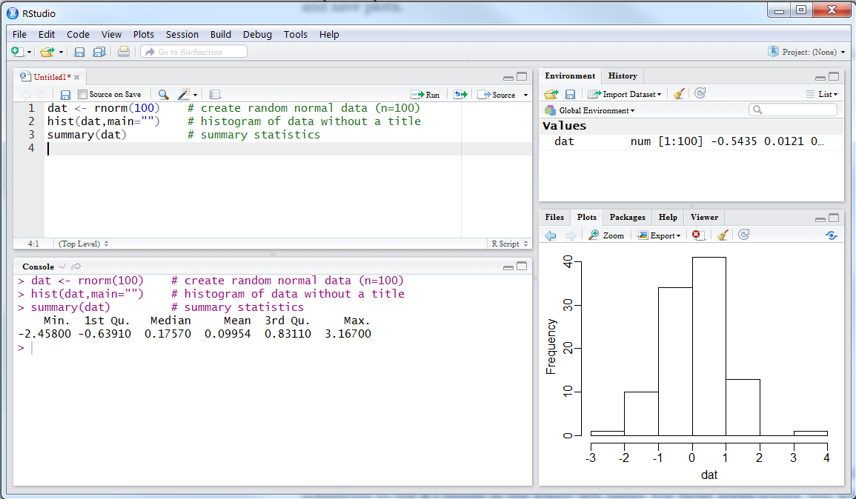
1. Univariate
Linear Models
2. Multivariate
Linear Models
3. Generalized
Linear Models
Steps in development of
statistical models (tutorial)

Slide 33
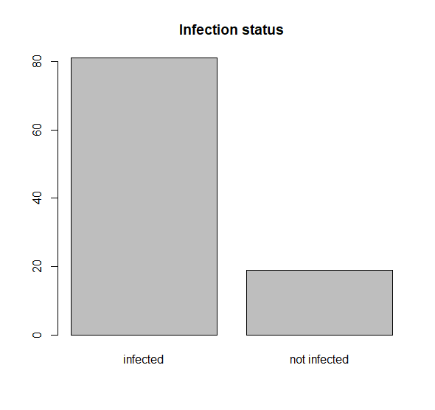
3
Database construction and descriptive analyses
Distribution of the response variable
Distribution of the explanatory variables
hist(mydata$var)
hist(mydata$var)
plot(mydata$var)

Slide 34
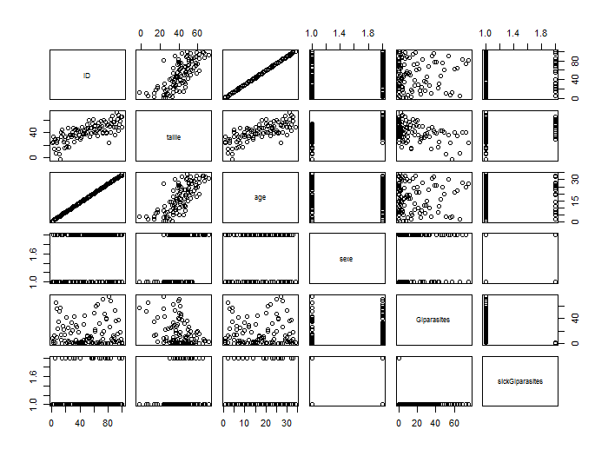
3
Database construction and descriptive analyses
pairs(mydata)
Relationships between the variables

Slide 35
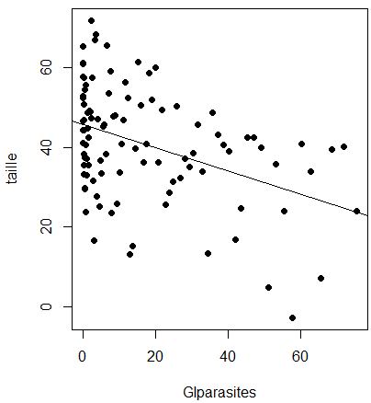
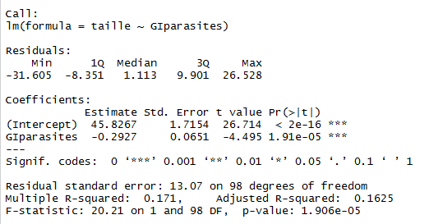
3
Univariate analyses
Quantify the stregth of the relationship between the response variable and each explanatory variable
Test the significance of the relationship between the response variable and each explanatory variable
Model1 = lm(taille~GIparasites, data=mydata)
summary (Model1)

Slide 36
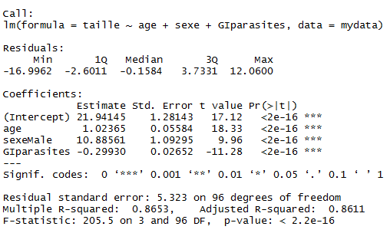
3
Multivariate analyses
Quantify the relationship between the response variable and a set of explanatory variables
Model1 = lm(taille~age+sexe+GIparasites, data=mydata)
summary (m1)
Select the set of predictors that best explains the response variable (backwards, forward, stepwise)
drop1 (m1)
add1 (m1)
step (m1)

Slide 37
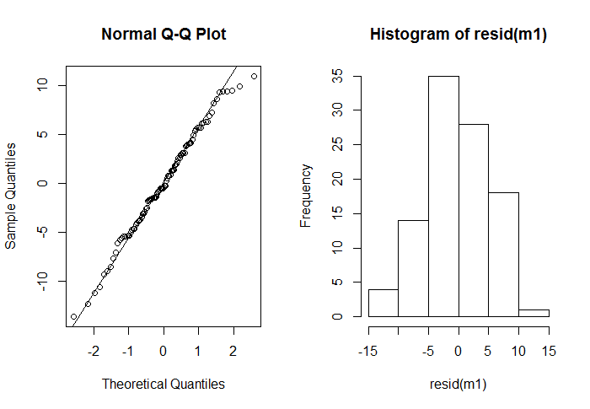
3
Model validation
Check that model assumptions have not been violated
Normality of residuals

Slide 38
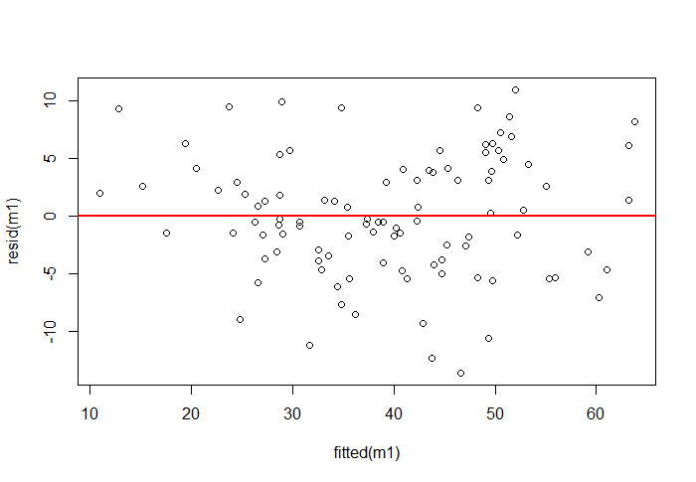
3
Model validation
Check that model assumptions have not been violated
Homogeneity of residuals

Slide 39
1. Univariate
Linear Models
2. Multivariate
Linear Models
3. Generalized
Linear Models
4. Generalized Linear
Mixed Models
Introduction to Generalized
Linear Mixed Models

Slide 40
Assumption and limitation of glms
all observations are considered independent

Slide 41

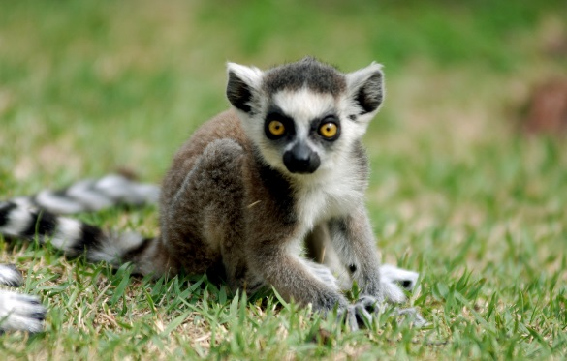
What if…?
taille
age

Slide 42
Why use GLMMs?
Generalized linear mixed models include both fixed effects and random effects in order to allow for:
Repeated measures
Temporal correlation
Spatial correlation
Heterogeneity
Nested data
yi = Xiβ + Zibi + εi
Fixed
Effects
Random
Effects
The R function to fit a generalized linear mixed model is glmer() which uses the form
fitted.model <- glmer(formula, family=“model family”, data=data.frame)

Slide 43
Repeated measures
Legend
District
CSB1
CSB2 PAUSENS
CSB2 PAUSENS + PIVOT
Model predictions with program(s)
Model predictions without program(s)
Health center 1
Health center 2
Health center 3
Month 1
Month 2
Month 3
Month 4
Month 5
PIVOT Program
Pausens Program
2013
2014
2015

Slide 44
Spatial correlation
District
Cluster 1
Cluster 2
Cluster 3
HH 1
HH 2
HH 3
HH 4
HH 5

Slide 45
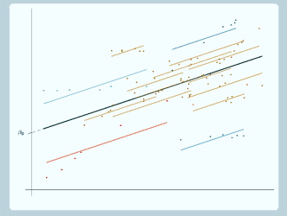
Random intercept
The intercept is different for each individual/site
Accounts for baseline differences in the response variable between individuals/sites

Slide 46
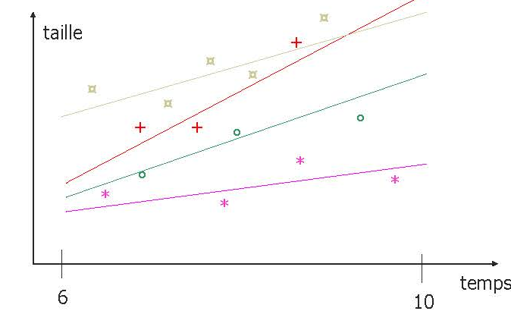
Random slope
The effect of a variable (b) is different for each individual/site
Accounts for baseline differences in the relationship response-explanatory variable between individuals/sites

Slide 47
1. Univariate
Linear Models
2. Multivariate
Linear Models
3. Generalized
Linear Models
4. Generalized Linear
Mixed Models
5. Evaluating trends and effects over time
Now that we can model repeated observations over time…

Slide 48
3
Introducing time-dependent trends
a) Linear trends (days, months, years)
Time = 1, 2, 3, 4, …, N
Where N is the total number of observations for each individual or site (including NAs)
y
time
y
time

Slide 49
3
Introducing time-dependent trends
a) Linear trends
b) Seasonal trends
Season=sin(2*pi*(month_{i}-shift)/period)
Season=cos(2*pi*(month_{i}-shift)/period)

Slide 50
3
Evaluating abrupt and progressive changes over time
Immediate impact
0 before the event happened
1 after the event happened
Impact =
Event
y
time

Slide 51
3
Evaluating abrupt and progressive changes over time
a) Immediate impact
b) Progressive impact
0 before the event happened
1, 2, 3, 4, …, N
after the event happened
Impact =
Event
y
time

Slide 52
3
Back to the initial example

Slide 53
The use of Generalized Linear Mixed Models for the study of dynamical systems
Andrés Garchitorena
Researcher, Institut de Recherche pour le Développement
Research Advisor, PIVOT Madagascar
E²M² Workshop
Ranomafana, January 2019

